Slide 1
Bee stock management system
Group – 07 (Developer track)

Slide 2
Group members details
Name Reg. No
S.KATHEESKUMAR BAT/IT/2018/F/0030
Y.VEANUPRIYAN BAT/IT/2018/F/0044
HKM.SHATHTHIR BAT/IT/2018/F/0021
JF.FARHANA BAT/IT//2018/F/0090
MS.MUFASA BAT/IT/2018/F/0063

Slide 3
Background
This project is about with developing a stock management system for Thiva multi center.
It is located in Main Street Thandiyadi , Kannankudah , Batticaloa.

Slide 4
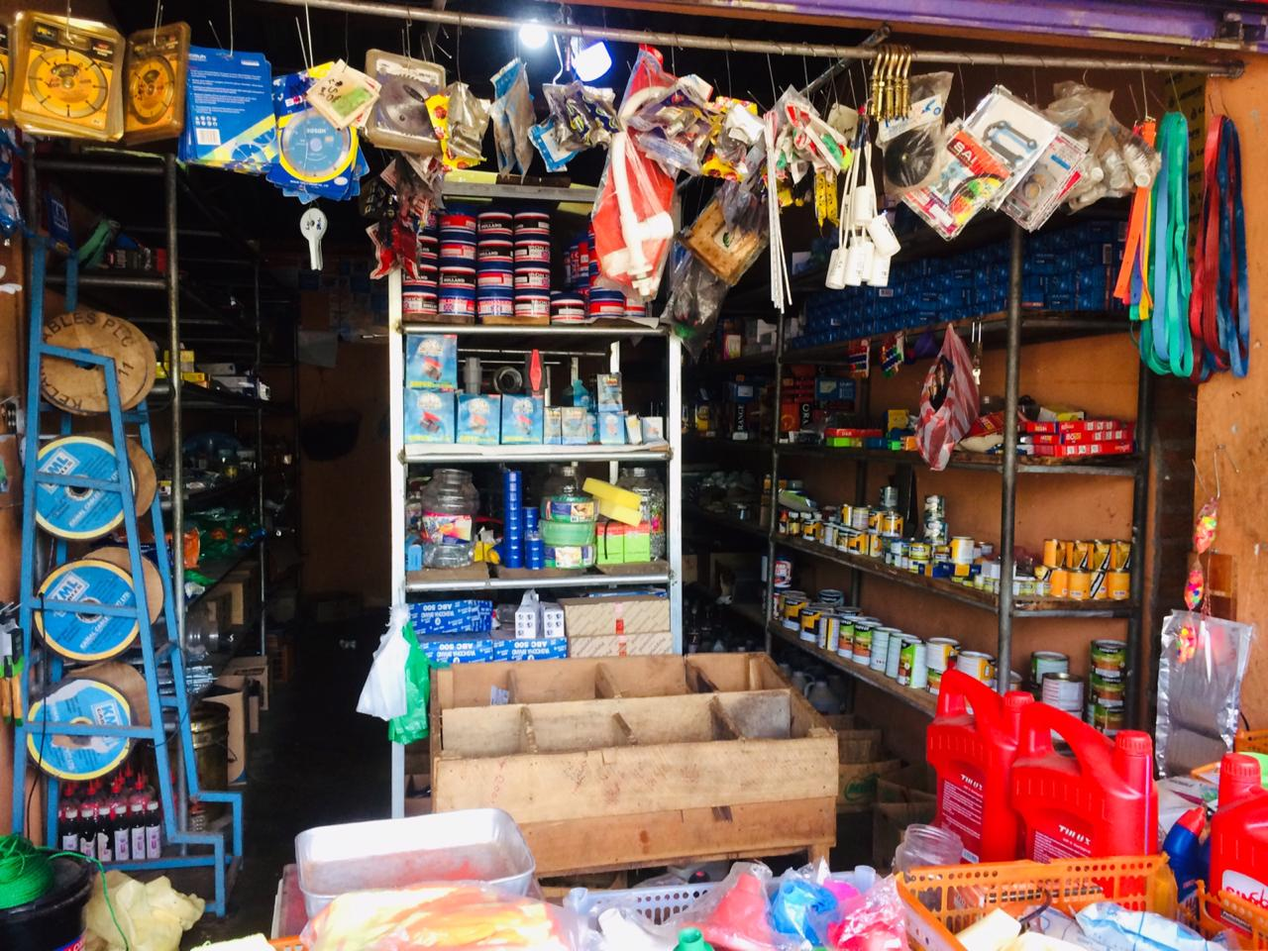
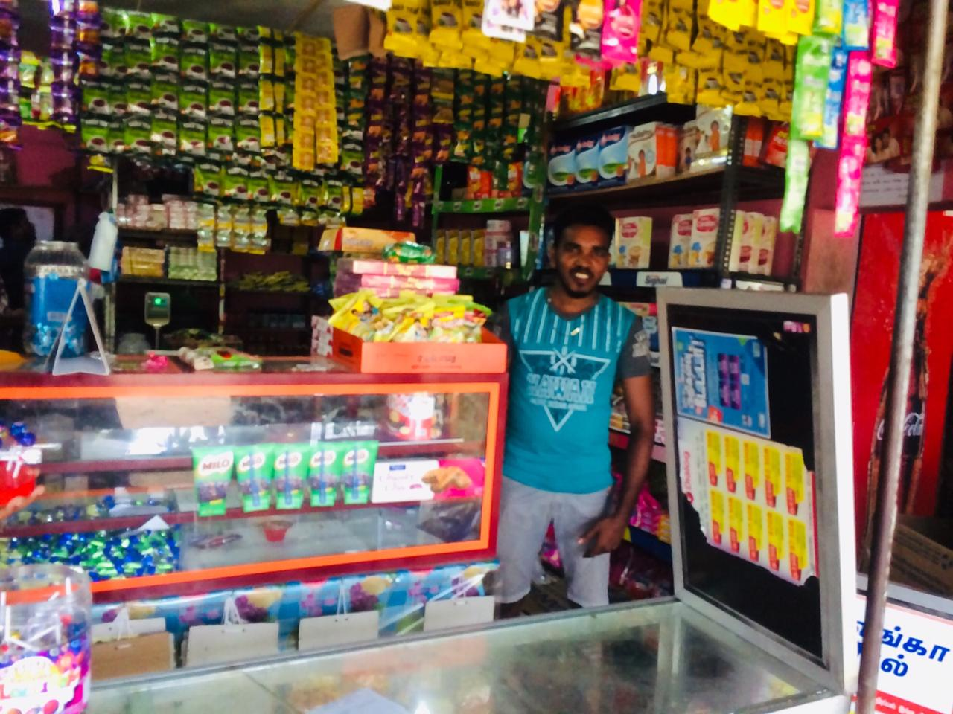
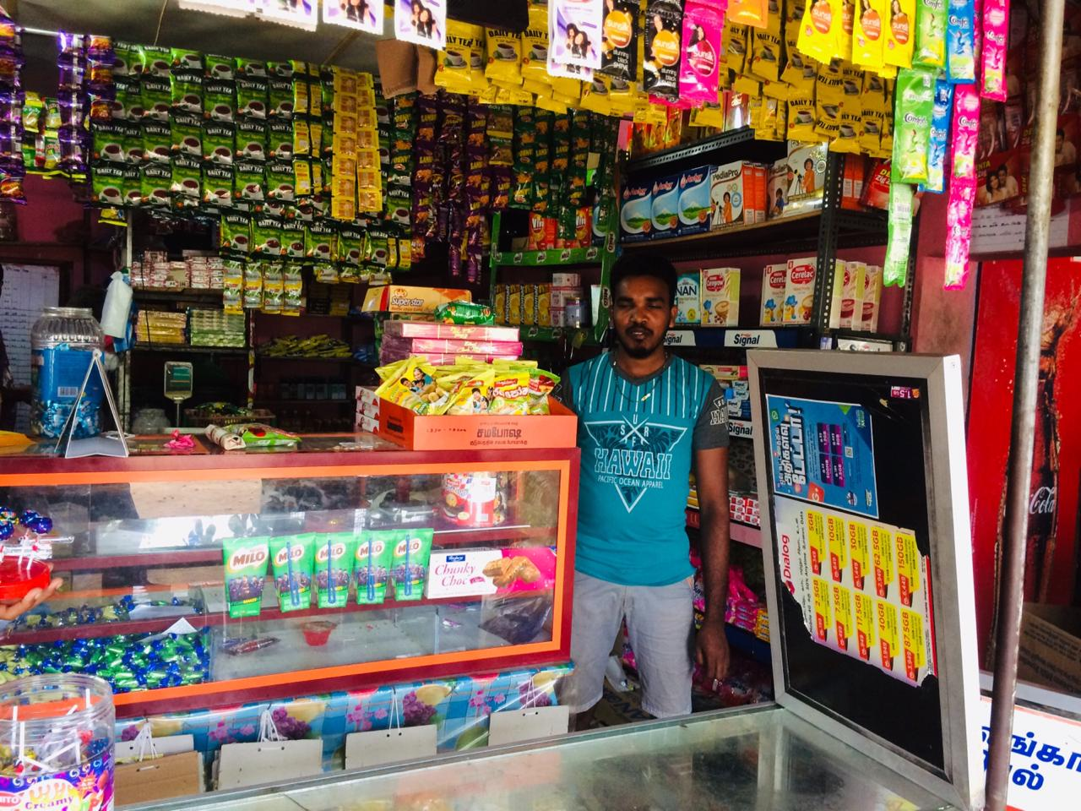
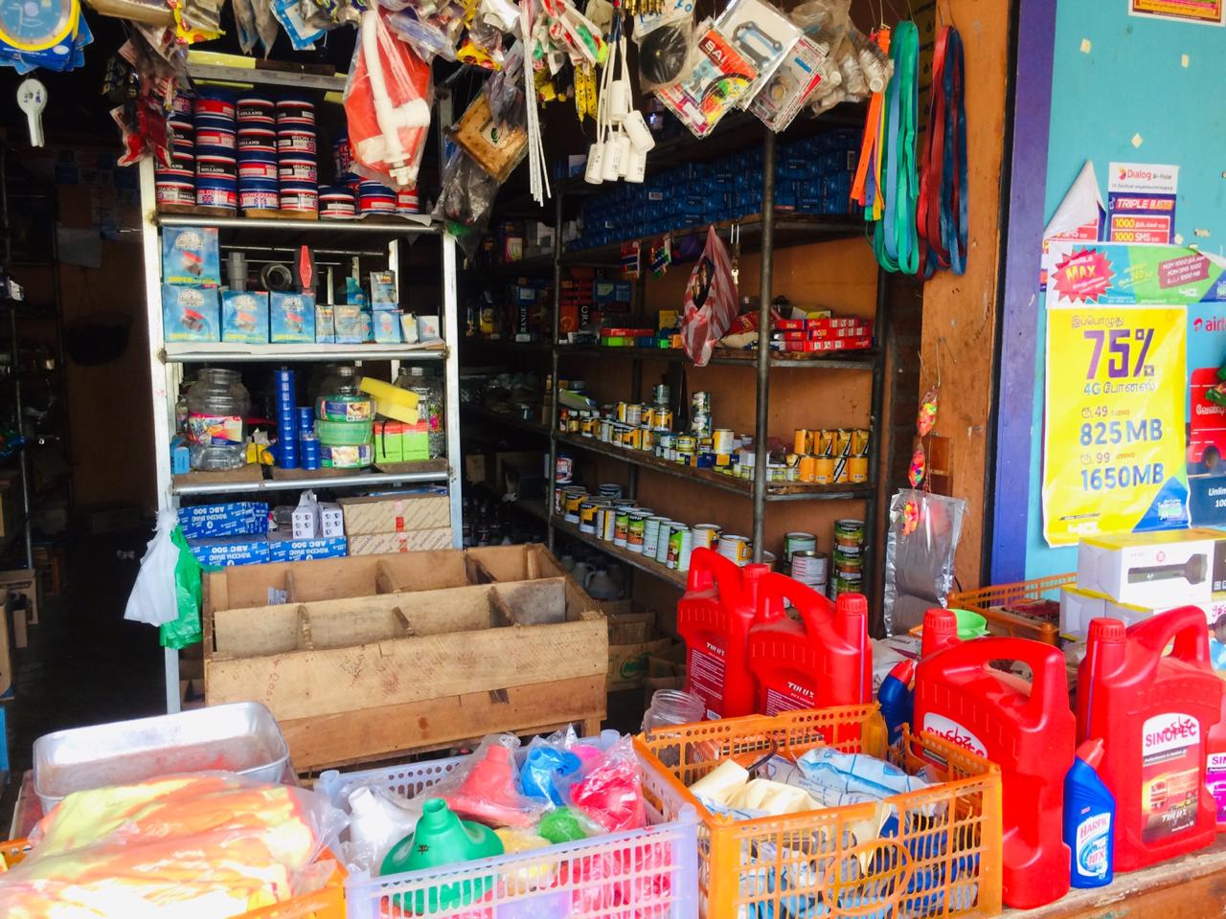
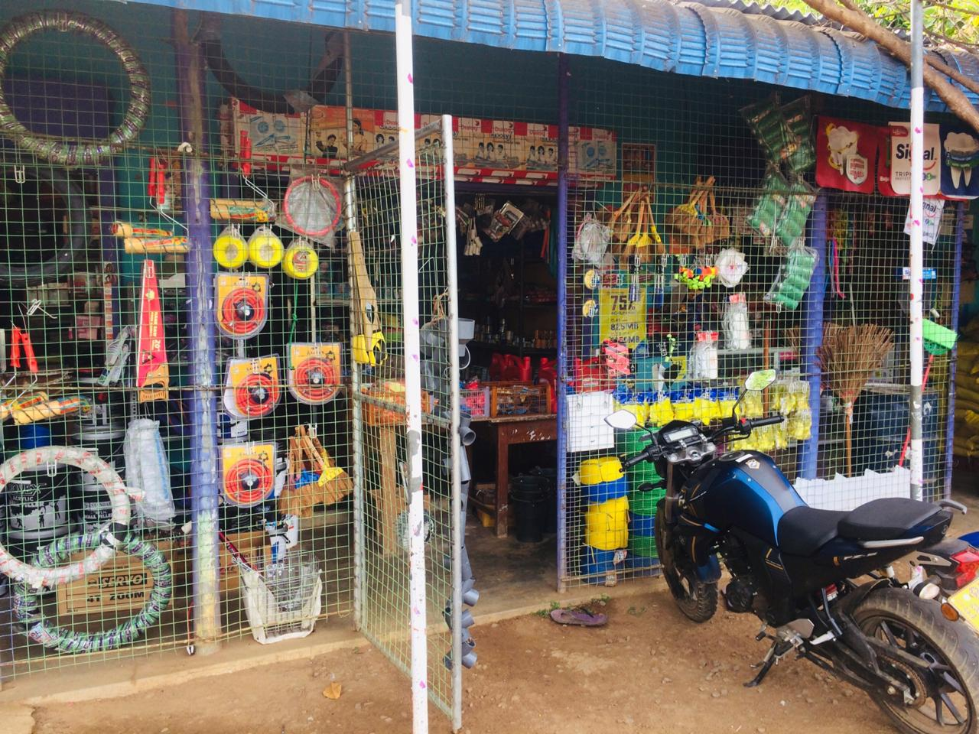
THIVA MULTI CENTER PHOTOS

Slide 5
Problems
Lack of security
Paper document filing can be less secure than computerize filing
systems.
Access time
Manual document filing is very time consuming
Poor communication
Purchasing scheduling and production departments problems
.
Tracing a stock details is difficult
When there is no computerized system there is always a difficulty in searching of stock details

Slide 6
Requirements
All stock details added
Possible to sell products directly within it
A purchase details will be programmed
Search option
Stock return system also programmed
Sales in purchase analyze option
Check the money transaction for the day

Slide 7





LANGUAGE
HTML : This language is use for developing static pages our system
CSS (Bootstrap) : This language is use for formatting our system
JAVASCRIPT (jQuery & AngularJS) : This language is use for validation or authentication.
PHP (LARAVEL) : This language is use to work over the system dynamically.
MY SQL : This is use for developing a database of our system.

Slide 8
THANK YOU

